Slide 1
NYSSO TRAINING PRESENTATION
Created by Brad White
All Rights Reserved
No Reproduction, Publishing or Dissemination
Without Prior Written Consent

Slide 2
EXPECTATIONS
Improved Training
Emphasis on Rule
Common Sense + Thoughtful Reasoning + Good Judgment
Emphasis on Mechanics
Teaching PROPER Mechanics, not YOUR Mechanics
Preparing umpires for state finals

Slide 3
NEW RULES
&
MODIFICATIONS

Slide 4
USA Softball Rule Changes of Relevance to NYSPHSAA
Multiple Significant Changes/Modifications in 2022 and in Recent Years
NYSPHSAA Changes
A lot has changed for those who “opted out” in 2020 & 2021

Slide 5
BAT GRIP
Rule 3-1-d
Delete the sentence; “Any attachment such as a molded finger grip, flare cone or choke up device must be attached with grip tape.”
Removes the requirement to use tape to attachments added to the grip.

Slide 6
THE BALL
Rule 3-3-a
Amends to specifications of the softball
Creates common specifications for the 12” Fast Pitch ball for USA Softball, NCAA and NFHS.
This is effective in 2024.

Slide 7
EXTRA PLAYER (EP)
Rule 4-1-d & e
(D) allows for ONE EP so you can bat 10.
(E) allows you to use the DP/Flex with ONE EP to bat 10 players.
In both D and E, any player in the line-up can play defense.
Substitutions for the pitcher and catcher must be reported.
In E the DP/Flex Rule is in effect so if the Flex is taken out of the defense it is a substitution.

Slide 8
LEAPING
Rule 6A-3-k
Pushing off and dragging the pivot foot in contact with the ground or having both feet in the air is allowed.
Allows the pitcher to have both feet in the air at the same time but must still stay within the 24” pitching plate.
“Crow Hopping” is still illegal
Crow hopping into a leap is illegal

Slide 9
CERTIFICATION MARKS
The official bat must bear either:
ASA 2000
ASA 2004
New approved “USA Softball”
NOTE 1: Bats with ASA 2013 certification marks are NOT approved for NYSPHSAA play
NOTE 2: ASA/USA Softball certification marks are not required for softballs
.47 COR & 375 Compression

Slide 10
HELMETS
Helmets shall have a non-glare (not mirror-like) surface
The difference between “shiny” and “mirror-like” is apparent

Slide 11
PITCHER’S SET-UP
The pitcher shall take a position with her pivot foot in contact with the pitcher’s plate and her non-pivot foot in contact with or behind the pitcher’s plate
Pitcher is no longer required to start with both feet on the pitcher’s plate
Pitcher must still be within 24-inch pitcher’s plate
“Within” means “no portion outside” behind the pitcher’s plate
“Within” means “touching” in front of the pitcher’s plate

Slide 12
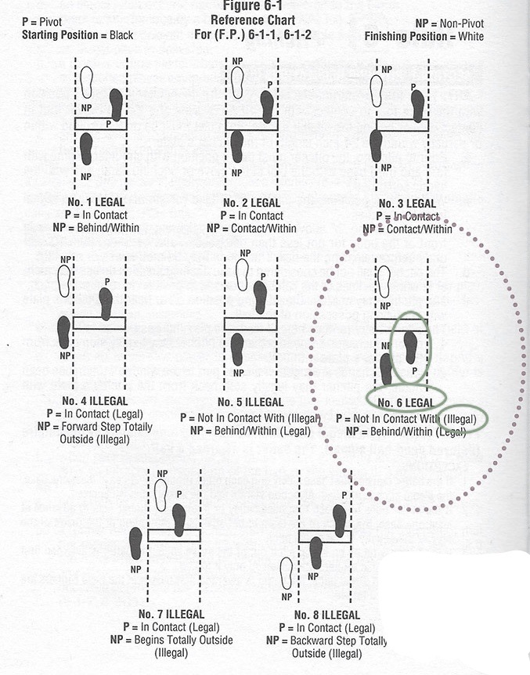
ILLEGAL
i
Not Within

Slide 13
PITCHER’S MOTION
A backwards step may be taken before, simultaneous with or after the hands are brought together
COMMENT: “Allows pitchers to take a backward step from the pitcher’s plate”

Slide 14
PITCHER’S MOTION
NOTE 1: The comment is misleading.
The pitcher may step back regardless of whether she started with both feet on the pitcher’s plate or with one foot behind the pitcher’s plate
NOTE 2: Hands & Feet
Stepping back as it relates to when the hands come together is more liberal than other rule sets
NOTE 3: Once the hands have separated (beginning of the pitch) a step back is not permitted

Slide 15
ILLEGAL PITCH
Eliminates the penalty of advancing a runner one base without liability to be put out from the effect of committing an illegal pitch
Penalty is limited to a “ball on the batter”
What happens if an illegal pitch results in a hit-by-pitch?
By rule, the hit-by-pitch penalty is enforced and the batter must take 1st base
NOTE 1: If the batter reaches 1st base and all other runners advance 1 base, the play stands
If a runner/batter-runner safely advances one base and elects to go beyond that one base, they are still considered to have advanced one base

Slide 16
METAL CLEATS
PERMITTED
VARSITY
JV
FRESHMAN/FROSH
NOT PERMITTED
MODIFIED
NYSPHSAA FINALS
Based solely on field restrictions

Slide 17
 | No. | PLAYERS | Pos.
1 | 22 | AVA | SS
sub
2 | 24 | BELLA | 2B
sub
3 | 26 | CLAIR | 3B
sub
4 | 28 | DAISEY | CF
sub
5 | 30 | EMMA | EP
sub
6 | 32 | FIONA | C
sub
7 | 34 | GINA | DP
sub
8 | 36 | HANNAH | 1B
sub
9 | 38 | IZZY | LF
sub
10 | 40 | JANE | RF
sub
11 | 42 | KATE | FLEX - F1
sub
 | No. | SUBSTITUTES
 | 44 | LUNA
 | 46 | MIA
 | 48 | NICOLE
 | 50 | OLIVIA

Slide 18
LINE-UPS
STRAIGHT 9
SHORT-HANDED 8
DP/FLEX
EP
DP/FLEX + EP

Slide 19
LINE-UPS
CANNOT CHANGE “FORMAT” ONCE OFFICIAL
SHORTHANDED
May only play ”down” one offensive player
I.e., if using an EP, they may only drop to 9 players in the offensive lineup
8 offensive players under this scenario results in forfeiture
I.e., if using a standard 9 player line-up or the DP/Flex (only), they may drop to 8 offensive players
7 offensive players under this scenario results in forfeiture
MUST BE LISTED CLEARLY
MAY NOT HAVE ADEQUATE SPACE ON PAPER
Make it work, but be clear

Slide 20
REMINDERS
No penalty for an unreported substitution
Defensive changes do not need to be reported
Exceptions:
Pitcher
Catcher
Flex
When using the DP/Flex and/or EP, any of the players in the line-up can play defense

Slide 21
REMINDERS
DP & Flex may not be on offense at the same time
If Flex enters offensive line-up, she must do so in the DP’s spot
DP may never be on defense only
DP is always in an offensive spot
Flex may never be on offense only
Exception:
If the Flex enters the offensive line-up for the DP and the EP is playing defense for another player, then the Flex will be on offense only

Slide 22
 | No. | PLAYERS | Pos.
1 | 22 | AVA | SS
sub
2 | 24 | BELLA | 2B
sub
3 | 26 | CLAIR | 3B
sub
4 | 28 | DAISEY | CF
sub
5 | 30 | EMMA | EP
sub
6 | 32 | FIONA | C
sub
7 | 34 | GINA | DP F1
sub
8 | 36 | HANNAH | 1B
sub
9 | 38 | IZZY | LF
sub
10 | 40 | JANE | RF
sub
11 | 42 | KATE | FLEX - F1
sub
 | No. | SUBSTITUTES
 | 44 | LUNA
 | 46 | MIA
 | 48 | NICOLE
 | 50 | OLIVIA
After the line-up is official, the coach states, “My DP is going in to pitch.”
Umpire must confirm:
Are they dropping the Flex?
Is the Flex staying in the game and another batter in the line-up no longer playing defense?

Slide 23
 | No. | PLAYERS | Pos.
1 | 22 | AVA | SS
sub
2 | 24 | BELLA | 2B
sub
3 | 26 | CLAIR | 3B
sub
4 | 28 | DAISEY | CF
sub
5 | 30 | EMMA | EP
sub
6 | 32 | FIONA | C
sub
7 | 34 | GINA | DP F1 DP
sub
8 | 36 | HANNAH | 1B
sub
9 | 38 | IZZY | LF
sub
10 | 40 | JANE | RF
sub
11 | 42 | KATE | FLEX - F1
sub |  | KATE | F1
 | No. | SUBSTITUTES
 | 44 | LUNA
 | 46 | MIA
 | 48 | NICOLE
 | 50 | OLIVIA
After Gina gives up back-to-back homeruns, the coach says, “Kate is going in to pitch.”
Umpire must confirm:
Is Kate entering the game for Gina?
Is Kate returning as the Flex and Gina remains in the batting order?

Slide 24
 | No. | PLAYERS | Pos.
1 | 22 | AVA | SS
sub
2 | 24 | BELLA | 2B
sub
3 | 26 | CLAIR | 3B
sub
4 | 28 | DAISEY | CF
sub
5 | 30 | EMMA | EP
sub
6 | 32 | FIONA | C
sub
7 | 34 | GINA | DP F1 DP
sub
8 | 36 | HANNAH | 1B
sub
9 | 38 | IZZY | LF
sub
10 | 40 | JANE | RF
sub
11 | 42 | KATE | FLEX - F1
sub |  | KATE | F1
 | No. | SUBSTITUTES
 | 44 | LUNA
 | 46 | MIA
 | 48 | NICOLE
 | 50 | OLIVIA
The coach says, “My EP is going to right-field.”
Although the coach may report this, it is not required.
This is merely a defensive change that does not involve the pitcher, catcher or Flex.
The EP “location” does not move in the line-up

Slide 25
 | No. | PLAYERS | Pos.
1 | 22 | AVA | SS
sub
2 | 24 | BELLA | 2B
sub
3 | 26 | CLAIR | 3B
sub
4 | 28 | DAISEY | CF
sub
5 | 30 | EMMA | EP
sub
6 | 32 | FIONA | C
sub
7 | 34 | GINA | DP F1 DP
sub
8 | 36 | HANNAH | 1B
sub
9 | 38 | IZZY | LF
sub
10 | 40 | JANE | RF
sub
11 | 42 | KATE | FLEX - F1
sub |  | KATE LUNA | F1
 | No. | SUBSTITUTES
 | 44 | LUNA
 | 46 | MIA
 | 48 | NICOLE
 | 50 | OLIVIA
Kate, the pitcher, also gives up back-to-back homeruns. The coach says, “Luna is going in for Kate.”
Kate has now been removed from the line-up twice. Kate can longer play.
Note: Kate’s removal, as an individual player, has no effect on the DP/Flex role
DP/Flex is not affected by an individual player’s eligibility

Slide 26
 | No. | PLAYERS | Pos.
1 | 22 | AVA | SS
sub
2 | 24 | BELLA | 2B
sub
3 | 26 | CLAIR | 3B
sub
4 | 28 | DAISEY | CF
sub
5 | 30 | EMMA | EP
sub
6 | 32 | FIONA | C
sub
7 | 34 | GINA | DP F1 DP
sub
8 | 36 | HANNAH | 1B
sub
9 | 38 | IZZY | LF
sub
10 | 40 | JANE | RF O/P
sub
11 | 42 | KATE | FLEX - F1
sub |  | KATE LUNA | F1
 | No. | SUBSTITUTES
 | 44 | LUNA
 | 46 | MIA
 | 48 | NICOLE
 | 50 | OLIVIA
Jane has now dropped two easy pop flies in right field. The coach says, “Gina is going to right field.”
Jane remains in the line-up. Jane is now considered an offensive only player (O/P).
This defensive change does not need to be reported since it does not involve the pitcher, catcher or Flex.

Slide 27
MOST FREQUENTLY MISSED QUESTIONS

Slide 28
If a courtesy runner is used for the pitcher in the top of the 1st inning, that pitcher is required to pitch to one batter in the bottom of the 1st inning.
The pitcher may only step back during her delivery if she initially started with both feet in contact with the pitcher’s plate.
Bats that contain the proper ASA/USA Certification Mark but also the USSSA Certification Mark are illegal.

Slide 29
B1 hits an over-the-fence home run. As she rounds 3rd base and is heading home, she removes her helmet and tosses it in the air in celebration. B1 is ruled out for intentionally removing her helmet. This is the proper ruling.
An offensive coach is yelling out location of pitches once he sees where the catcher is setting up. The umpires rule this to be unsporting conduct and issue a warning. This is the proper procedure.
The plate umpire should instruct players to raise their hands if the player believes the ball has gone out of play.

Slide 30
When a runner abandons a base and enters the team area or leaves live ball territory:
The ball is dead;
The runner is out;
Runners must return to the last base touched at the time of the infraction;
All of the above.

Slide 31
When a runner’s interference prevents a fielder from catching a routine fly ball with ordinary effort:
Only the batter is out;
Only the runner is out;
Only a strike is charged to the batter if the ball is foul;
Both the runner and batter are out.

Slide 32
Obstruction will be called:
With R1 on 1st base, F3 stands directly in the baseline between 1st base and 2nd base.
Whenever F2 and B1 collide after a batted ball.
When, on a safe hit to the outfield, F6 impedes the progress of R1 about ten feet behind the baseline;
All of the above.

Slide 33
LIVE / DELAYED DEAD / DEAD
A runner contacts a fielder who does not have a legitimate chance to make a play on a batted ball.
An obstructed runner is tagged out between the two bases where the obstruction occurred.
At the time plate umpire interference occurs.

Slide 34
With R2 on 2nd base, B3 is struck by an illegal pitch. R2 is awarded ___.
R1 on 1st base is attempting to steal 2nd base. F2’s careless throw strikes B3’s bat and the ball goes out of play. R1 is awarded ____.
R1 from first base is attempting to steal second when B1 hits a ground ball to F6. F6 throws to first but the ball enters dead ball territory. At the time of the throw, R1 had already touched second base. R1 is awarded ___.

Slide 35
R1 from first running on B1’s long hit to the outfield is nearing third base and easily scored when the ball bounces over the outfield fence. R1 is awarded ___.
F2 throws to F3 attempting to pickoff R1 at 1st base. Sliding back into 1st base, R1’s foot knocks the ball out of F3’s glove and the ball enters dead ball territory. R1 is awarded ____.

Slide 36
MECHANICS CHANGES

Slide 38
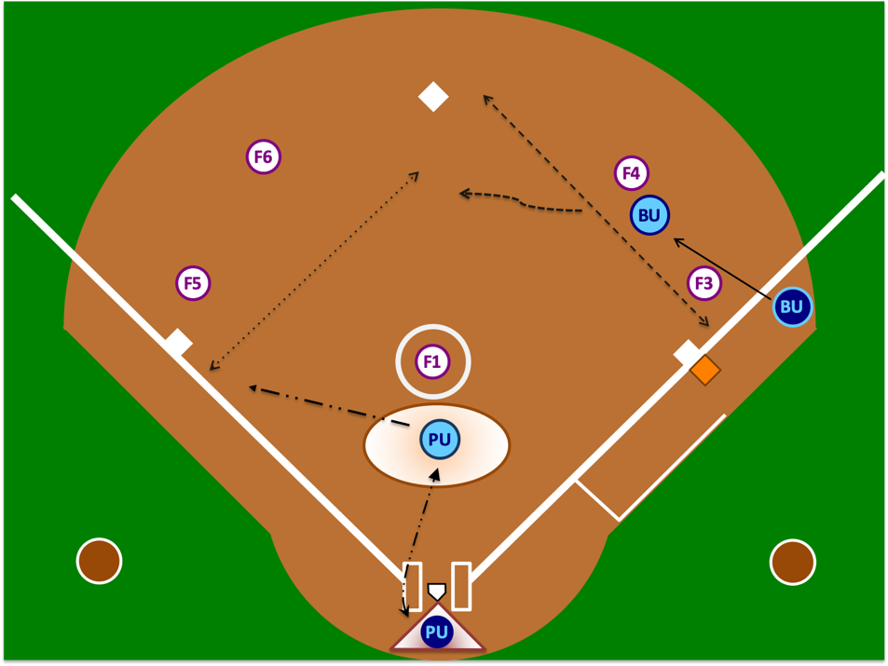
“A” POSITION – Hit to Center or Left Field or to Right Field Where it is Clear Batter-Runner Will Not Advance to 2nd Base - “The Rim”

Slide 39
“A” POSITION – Single to Right Field and Batter-Runner May Advance “The Buttonhook”

Slide 40
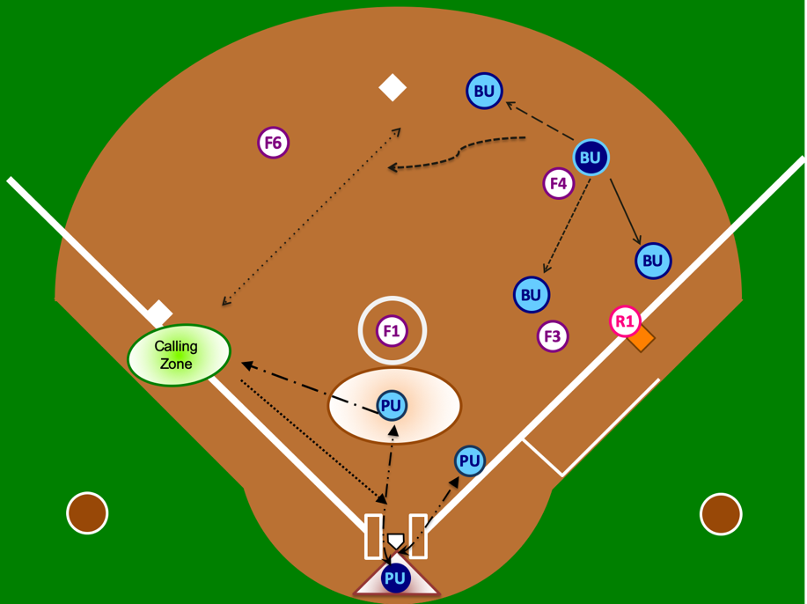
“B” POSITION – All Movements

Slide 41
OBSTRUCTION
Whenever obstruction occurs, it must be called. The severity of the obstruction does not dictate whether the umpires will call the obstruction. Obstruction is obstruction and must be properly called like any other call.
Proper Mechanic
Verbalize “That’s obstruction” while pointing to the infraction with your right arm.
Then, signal obstruction by extending your left arm perpendicular to your body with a closed fist.
The verbal call should be loud enough for those around you to hear and the visual signal should be held long enough for others to see.
Do NOT run around the field with your arm out. Drop your arm and attend to your other responsibilities.

Slide 42
OBSTRUCTION
If the obstruction runner is declared out between the two bases where the obstruction occurred or prior to reaching the base to which she is protected, the following mechanics are used:
Declare “dead ball” or “time.”
Re-announce “that was obstruction” while pointing to where the obstruction occurred.
Award the proper base(s).
Do NOT call the obstructed runner out, then kill the play, then award bases. This is not the proper technique, causes confusion and looks terrible.

Slide 43
MODIFIED “C” POSITION R3 on 3rd Base Only R3 on 3rd & R1 on 1st Base 2 Outs & Full Count with Bases Loaded or R2 on 2nd Base & R1 on 1st Base

Slide 44
NO RUNNERS ON BASE – CLEAR OVER-THE-FENCE-HOMERUN
3BU
1BU
R3
PU

Slide 45
R1 ON 1ST BASE – CLEAR OVER-THE-FENCE-HOMERUN
3BU
3BU
1BU
R1
PU

Slide 46
MECHANICS POINTS OF EMPHASIS
PRESENT A UNITED FRONT
PLATE UMPIRE TIMING
3RD STRIKES
AVOID GAME INTERRUPTERS
DEVIATIONS
TAG-UPS
HOMERUN COVERAGE
STAYING OUTSIDE

Slide 47
BU
R2
F6
F4
BU
R3
R1
F5
F1
F3
F2

Slide 48
PLAYS & INTERPRETATIONS

Slide 49
SITUATION 1
May a player wear religious headwear?
AR1
Yes. Provided the use of safety equipment (e.g., batter’s helmet) is not compromised, a player may wear religious headwear.

Slide 50
SITUATION 2
May a HS game be played with foul poles but without outfield fencing?
AR 2
A HS softball contest shall not be canceled due to a field containing foul poles but no outfield fencing.

Slide 51
SITUATION 3
There seems to be a lot of talk about the Easton “Ghost” bat. Which bats are legal for HS play?
AR 3
The bats that meet the requirements of the rulebook are legal. The requirements include, but are not limited to, the 2000 or 2004 ASA/USA Certification Mark.

Slide 52
SITUATION 4
Are bats with the 2013 ASA Certification Mark legal?
AR 4
Not in HS play.

Slide 53
SITUATION 5
A player has a medical/NYSPHSAA waiver to wear a daith piercing/earring. Does it need to be taped?
AR 5
No.

Slide 54
SITUATION 6
I heard metal cleats are permitted in HS baseball, so they must be legal in HS softball, right?
AR 6
Wrong. Metal cleats are not permitted in HS softball. Metal cleats are permitted at the varsity, junior varsity and frosh/freshman levels. Metal cleats are not permitted in modified play. Updated 2020

Slide 55
SITUATION 7
With R3 on 3rd base and 2 outs, B4 lays down a squeeze bunt. R3 crosses home plate. Then, B4 is called out for 3-foot lane interference. Does R3’s run count since she crossed home plate before the 3-foot lane interference?
AR 7
No. No run shall score when the 3rd out of the inning is on the BR prior to reaching 1st base, regardless of how that out occurred.

Slide 56
SITUATION 8A
With R3 on 3rd base and R2 on 2nd base, F1 throws a passed ball. R3 advances aggressively toward home plate, but puts the brakes on when she realizes she would be out at the plate. R3 retreats back to 3rd base and is standing on 3rd base. R2 is also standing on 3rd base. F5 tags both R3 and R2 while they are standing on the base simultaneously. Who is out?
AR 8A
R2 is out. R3 is entitled to her base until she (1) advances to and reaches the next base or (2) is forced from the base as a result of the batter becoming a batter-runner (force play).

Slide 57
SITUATION 8B
What if on the same play, F5 tagged R2 standing on 3rd base right before R3 returned to 3rd base?
AR 8B
R2 would not be out at this point. 3rd base was not occupied by 2 runners at the same time and R2 was permitted to advance to 3rd base. She simply is not entitled to it if R3 returns and stands on 3rd base.

Slide 58
SITUATION 9A
The game is being played with a temporary fence. B1’s batted ball hits 6 inches below the top plain of the fence and “falls” over the fence. The fence was loose and “had some give.” The ball passed over the fence on the fly. Is this a homerun?
AR 9A
No. The batted ball must cross the natural plain of the top of the fence. In this case, pressure from the ball caused the fence to fold/roll. When the ball does this or “climbs” the fence, a 2 base award shall be granted.

Slide 59
SITUATION 9B
But what about the rule that says something like “if the ball hits the top of the fence and then goes over, it’s a home run?”
AR 9B
That is still true. However, the “top of the fence” means the actual top that faces upward toward the sky. “Top of the fence” does not mean the top couple of inches of the fence facing the field.

Slide 60
SITUATION 10A
With R2 on 2nd, B3 hits a long fly ball. The ball is caught & R2 tags up. Who’s responsible for what?
AR 10A
Because R2 is a sole runner and is on 2nd base, the base umpire is responsible for her tag up. The play on R2 going into 3rd base is the plate umpire’s responsibility. This mechanic is endorsed by NYSSO. Do not use another association’s mechanic if it deviates from this mechanic.

Slide 61
SITUATION 10B
Are there any possible deviations that NYSSO would accept on this play?
AR 10B
Yes. The SOLE exception is if the plate umpire is pinned at home plate because he/she must remain there to determine fair/foul and catch/no catch down the right field line. In that case, the plate umpire must loudly communicate this deviation to his/her partner by saying “take her” or “she’s yours” etc. This mechanic is a deviation and may only be used in the situation described above. Umpires cannot default to a deviation because they prefer to use outdated mechanics.

Slide 62
SITUATION 10C
What if R2 advances to 3rd base, the ball gets passed F5 and R2 attempts to advance home?
AR 10C
In this case, the plate umpire is responsible for getting back home and covering the play. This situation is clearly described in the NYSSO Manual. Unless the plate umpire drops dead on the field, the base umpire has absolutely no business covering home plate in the 2-umpire system.

Slide 63
SITUATION 11
Team A submitted an official line up card using the DP/Flex. After the 9th batter bats, the Flex bats, rather than the lead off batter. Is this batting out of order or something else?
AR 11
Batting out of order involves players 1-9 in the batting order, not the Flex. When the Flex bats without a line-up change being reported to the plate umpire, this is an unreported substitution. But that is only step one. Remember, there is no player penalty in NYSSO softball for an unreported substitution. With that said, step two is determining whether the Flex batted illegally. If the lead off batter was the DP, this can be ruled as an unreported substitution without penalty. However, if she batted for someone other than the DP, this move would be illegal. The penalties imposed will depend on the timing of this infraction being brought to the plate umpire’s attention.

Slide 64
SITUATION 12
A batting helmet has a NOCSAE stamp, but no external warning label. Is this permitted?
AR 12
Effective 2018, HS no longer requires the external warning label. The NOCSAE stamp, however, is still required.

Slide 65
SITUATION 13
Team A’s head coach reports a change to the plate umpire. Team A’s head coach then says, “I’ll let them know” referring to the opposing team. Is this a proper procedure?
AR 13
No. Although there is technically no prohibition to the coach reporting the information, it is the responsibility of the plate umpire to notify the opposing team. The proper response from the plate umpire should be along the lines of “That’s okay, coach; I will let them know.”

Slide 66
SITUATION 14
B1 is a right-handed batter. B1 bats the ball, which lands just outside the batter’s box in fair territory. B1 takes her first step toward 1st base and steps on top of or kicks the ball with her left foot. When B1 does this, her right foot is still within the batter’s box, but her left foot is outside the batter’s box.
AR 14
B1 is out for interference. B1 did not meet the definition of being “within” the batter’s box when she contacted the batted ball.

Slide 67
SITUATION 15A
R2 from 2nd base is advancing home on B3’s hit to the outfield. F2 is legally blocking the plate as R2 attempts to do a slide by and sneak her hand in. F2 misses the tag and R2 misses the plate. Can F2 make a live ball appeal for R2 missing home plate?
AR 15A
Yes, any player in possession of the ball may execute a live ball appeal. To do so, she must execute the appeal prior to the runner “fixing” her base running error. The player in possession of the ball may either tag the runner or tag the base where the “violation” occurred. In this case, F2 can simply make her live ball appeal known to the umpire and step on home plate prior to R2 touching home.

Slide 68
SITUATION 15B
Then why do catchers always chase after the runner who misses home plate?
AR 15B
Probably because they weren’t taught properly and because many don’t know how to execute a live ball appeal.

Slide 69
SITUATION 16A
B1 hits and over-the-fence home run. As she rounds 3rd base and is heading home, she removes her helmet and tosses it in the air in celebration. Is B1 out for intentionally removing her helmet?
AR 16A
No. There are multiple elements necessary to call a runner out for intentionally removing her helmet. One of those elements is that the ball is live. An over-the-fence home run becomes a dead ball.

Slide 70
SITUATION 16B
If a runner does intentionally remove her helmet during a live ball, why does the rule state that doing so does not remove the force?
AR 16B
It is intended to prevent the offense from benefiting from violating the rule. For instance, with R1 on 1st base, B2 hits a tailor-made double play. Seeing this, B2 intentionally removes her helmet just prior to the execution of R1’s out at 2nd base. Imagine that R1 were to be called safe because the defense attempted to execute a force out rather than a tag out, which ordinarily would be necessary when the BR is declared out? That would fundamentally change how the game is played and could not be tolerated.

Slide 71
SITUATION 17
The 3rd base coach requests time and asks to have the “last batted out” run for the runner on 1st base. She says, “We do that every game.”
AR 17
This is not legal. If an eligible courtesy runner is available for a pitcher or catcher, the team may use her. If an eligible substitute is available, she may be used. If neither exists, then R1 must run or be declared out for not running.

Slide 72
SITUATION 18A
The 3rd base coach requests time and reports to the plate umpire “#12 is batting for #20 and then #20 is going to re-enter.” Is this permissible?
AR 18A
Projected substitutions are not permitted. Projected substitutions involve multiple changes involving the same player. The umpire should state, “Coach, I’m entering #12 for #20; but, you’re required to report any future change with her.”

Slide 73
SITUATION 18B
Does that mean that the coach can’t report multiple batting changes? For example, if the team is ahead by 10 runs and the coach reports, “I’m entering #1 for #2, #3 for #4 and #5 for #6” is that permitted?
AR 18B
Yes. Although there are multiple changes, they involved different players, as opposed to multiple changes with the same player.
For what it is worth, just this past weekend a runner on second was gesturing location to the batter and the third base coach would yell “sit” when he knew the pitcher would throw a change up. Both are perfectly legal.
An umpire would be in error to issue a directive to a coach to stop calling location.

Slide 74
SITUATION 19: An offensive coach is yelling out location of pitches once he sees where the catcher is setting up. Is this “unsporting conduct?” Should any warnings be issued?
AR 19
There is no prohibition on stealing signs, pitches or location; nor is there a prohibition against using that information; provided in both cases it is not done illegally. Illegally is limited to cases involving the use of electronic equipment, game personnel going where they don’t belong, etc.
The solution is for the defensive team to set up later or more subtly. There are other solutions, but I cannot recommend they be implemented. Because, as described, there was no illegal conduct, there is nothing for which to issue a warning. Warnings should only be used when an actual violation occurs and there must be a penalty for a subsequent violation.

Slide 75
SITUATION 20
B1 comes to bat. After the first pitch to her, the plate umpire sees she is wearing jewelry. The plate umpire immediately ejects B1 and her head coach. Is this correct?
AR 20
No. If a player is wearing jewelry, she should be directed to correct the situation. She should be allowed a reasonable amount of time to correct it and then may play again. If she cannot or is unwilling to correct it, then a legal substitute would be required to take her spot. The only time an ejection would come into the picture is (1) if the same player put the jewelry back on after taking it off (unsporting conduct) or if she had tape covering the jewelry, lied about the fact that jewelry was under the tape and it was later discovered to be jewelry. In these cases, ejection is an option, which umpires are not required to exercise.

Slide 76
SITUATION 21A
Does the protection that an obstructed runner garners change depending on whether she is obstructed advancing to a base or returning to a base?
AR 21A
No. An obstructed runner is protected between the two bases where the obstruction occurred and to the base she would have reached, in the umpires’ judgment, had she not been obstructed.

Slide 77
SITUATION 21B
F3 obstructs BR rounding 1st base on an outfield hit. F8 charges the ball, fields it cleanly and throws it directed to F6 covering 2nd base. BR never would have reached 2nd base safely. As soon as BR is obstructed, her 1st base coach yells “go to 2nd base.” BR is thrown out at 2nd base. What is the proper ruling?
AR 21B
Because BR was protected between 1st and 2nd base and was tagged out between those bases, the ball becomes dead. The umpires should safely return BR to 1st base

Slide 78
SITUATION 21C
F3 obstructs BR returning to 1st base on an outfield hit. F8 charges the ball, fields it cleanly and throws it directed to F6 covering 2nd base. BR never would have reached 2nd base safely. As soon as BR is obstructed returning to 1st base, her 1st base coach yells “go to 2nd base.” BR is thrown out at 2nd base. Does the ruling differ from Situation / AR 21B?
AR 21C
No. An obstructed runner is protected regardless of whether she is advancing to or returning to a base.

Slide 79
SITUATION 21D
When there is obstruction on BR rounding or returning to 1st base (e.g., on an outfield single), is there any reason the BR shouldn’t attempt to advance to 2nd base?
AR 21D
No. Provided BR doesn’t commit an act of interference, miss a base, etc., this is, in essence, a “free play.” If BR’s advancement draws a poor throw or the ball is misplayed and she reaches 2nd base safely, good for her. If she’s thrown out by 50 feet after never having a realistic chance of getting to 2nd base safely, the ball is dead and she is returned to 1st base.

Slide 80
TEST PREP
Frequently Missed Questions
Plays & Interpretations
New Rules
Pitcher Set Up
Pitcher Motion (Leaping)
Extra Player (EP)
Illegal Pitch
Certification Marks
Metal Cleats
Helmets
Mechanics

