Slide 1
NYSSO TRAINING PRESENTATION
Created by Brad White
All Rights Reserved
No Reproduction, Publishing or Dissemination
Without Prior Written Consent

Slide 2
EXPECTATIONS
Improved Training
Emphasis on Rule
Common Sense + Thoughtful Reasoning + Good Judgment
Emphasis on Mechanics
Teaching PROPER Mechanics, not YOUR Mechanics
Preparing umpires for state finals

Slide 3
NEW RULES
&
MODIFICATIONS

Slide 4
USA Softball Rule Changes of Relevance to NYSPHSAA
Multiple Significant Changes/Modifications
NYSPHSAA Changes

Slide 5
CERTIFICATION MARKS
The official bat must bear either:
ASA 2000
ASA 2004
New approved “USA Softball”
NOTE 1: Bats with ASA 2013 certification marks are NOT approved for NYSPHSAA play
NOTE 2: ASA/USA Softball certification marks are not required for softballs
.47 COR & 375 Compression

Slide 6
HELMETS
Helmets shall have a non-glare (not mirror-like) surface
The difference between “shiny” and “mirror-like” is apparent

Slide 7
PITCHER’S SET-UP
The pitcher shall take a position with her pivot foot in contact with the pitcher’s plate and her non-pivot foot in contact with or behind the pitcher’s plate
Pitcher is no longer required to start with both feet on the pitcher’s plate
Pitcher must still be within 24-inch pitcher’s plate

Slide 8
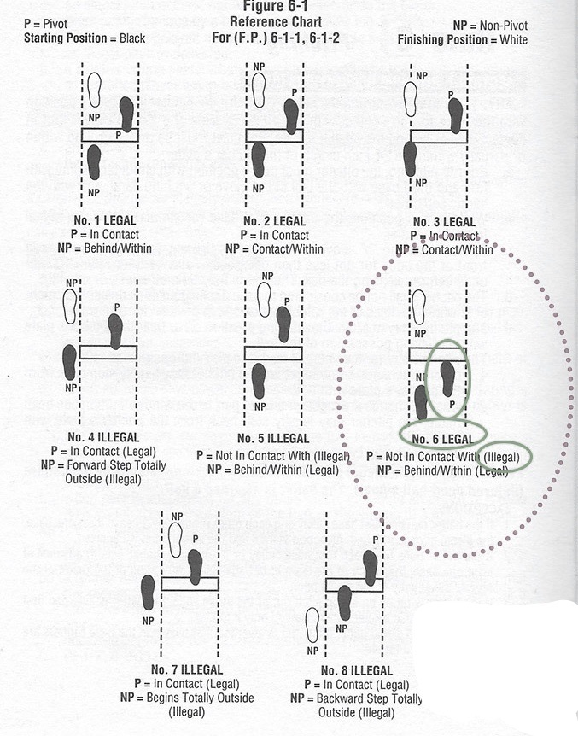

Slide 9
PITCHER’S MOTION
A backwards step may be taken before, simultaneous with or after the hands are brought together
COMMENT: “Allows pitchers to take a backward step from the pitcher’s plate”

Slide 10
PITCHER’S MOTION
NOTE 1: The comment is misleading.
The pitcher may step back regardless of whether she started with both feet on the pitcher’s plate or with one foot behind the pitcher’s plate
NOTE 2: Hands & Feet
Stepping back as it relates to when the hands come together is more liberal than other rule sets
NOTE 3: Once the hands have separated (beginning of the pitch) a step back is not permitted

Slide 11
ILLEGAL PITCH
Eliminates the penalty of advancing a runner one base without liability to be put out from the effect of committing an illegal pitch
Penalty is limited to a “ball on the batter”
What happens if an illegal pitch results in a hit-by-pitch?
NOTE 1: If the batter reaches 1st base and all other runners advance 1 base, the play stands

Slide 12
METAL CLEATS
PERMITTED
VARSITY
JV
FRESHMAN/FROSH
NOT PERMITTED
MODIFIED
NYSPHSAA FINALS
Based solely on field restrictions

Slide 13
MOST FREQUENTLY MISSED QUESTIONS

Slide 14
A runner cannot be obstructed by a fielder’s verbal call.
There cannot be a force out on a play when a fly ball is caught.
An appeal play can never result in a force out.
The ball is delayed-dead when 3-foot lane interference occurs.
If a courtesy runner is used for the pitcher in the top of the 1st inning, that pitcher is required to pitch to one batter in the bottom of the 1st inning.

Slide 15
On a checked swing, if the batter is hit on the hands, she cannot be awarded 1st base because the hands are part of the bat.
The batter is automatically out if the bat slips from her hands after being warned by the umpire.
The player who batted out of turn is declared out if a proper appeal is made after the at bat is completed and before the next pitch.
When a proper appeal is made, runners called out must return to the last bases occupied at the time of the pitch.
B1 is out if after hitting a ball she again hits the ball in fair territory while holding her bat and any portion of her foot is out of the batter’s box and touching the ground.

Slide 16
If BR overruns 1st base and starts back to the base, BR still may attempt to advance to 2nd base.
Provide an alternate ball to the pitcher when she requests another ball. Do not say, “You made your choice at the start of the inning. You must pitch that ball until it goes out of play.”
L / DD / D
An obstructed runner is tagged out between the two bases where the obstruction occurred.
At the time plate umpire interference occurs.
At the time a batted ball is touched by a thrown glove.

Slide 17
A runner contacts a fielder who does not have a legitimate chance to make a play on a batted ball.
When a runner abandons a base and enters the team area or leaves live ball territory:
The ball is dead;
The runner is out;
Runners must return to the last base touched at the time of the infraction;
All of the above.
R1 on 1st base is attempting to steal 2nd base. F2’s careless throw strikes B3’s bat and the ball goes out of play. R1 is awarded ____.

Slide 18
MECHANICS CHANGES

Slide 19
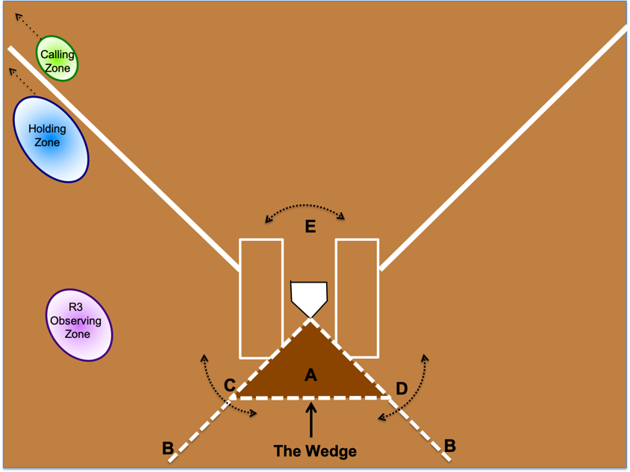

Slide 20
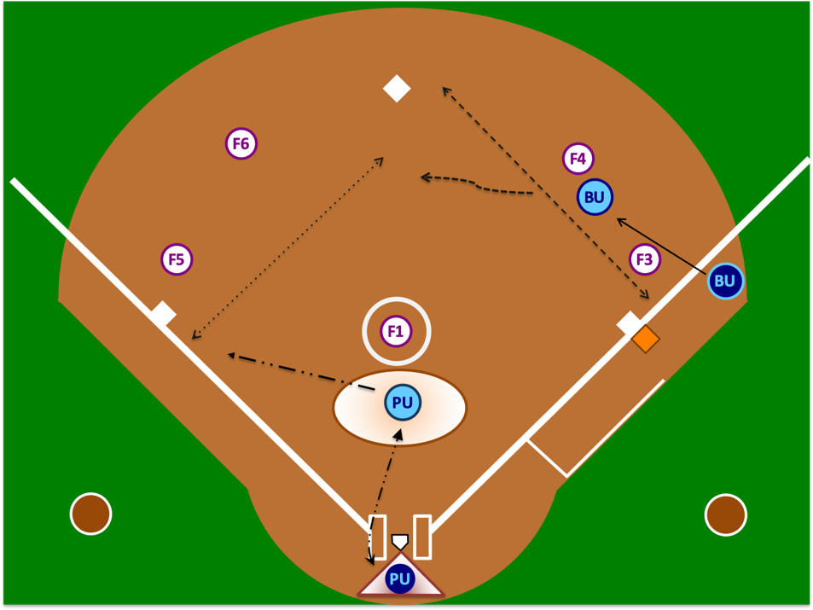
“A” POSITION – Hit to Center or Left Field or to Right Field Where it is Clear Batter-Runner Will Not Advance to 2nd Base - “The Rim”

Slide 21
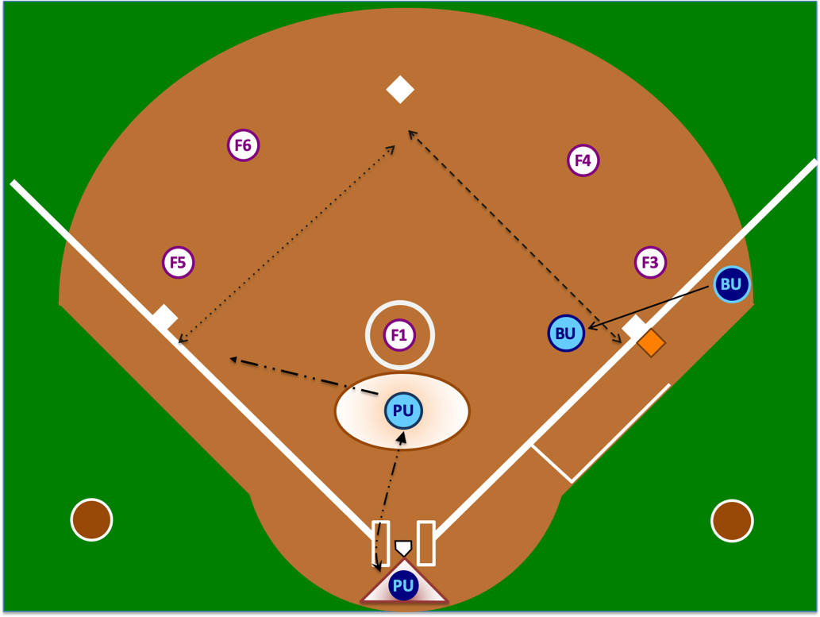
“A” POSITION – Single to Right Field and Batter-Runner May Advance “The Buttonhook”

Slide 22
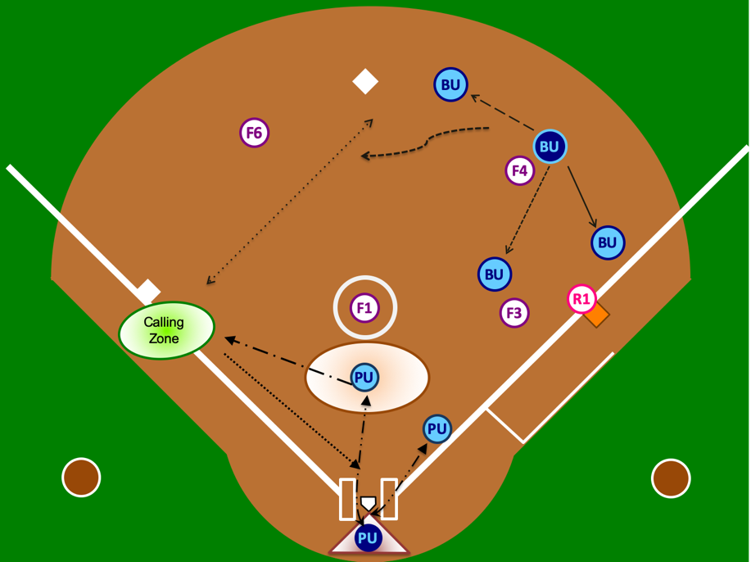
“B” POSITION – All Movements

Slide 23
OBSTRUCTION
Whenever obstruction occurs, it must be called. The severity of the obstruction does not dictate whether the umpires will call the obstruction. Obstruction is obstruction and must be properly called like any other call.
Proper Mechanic
Verbalize “That’s obstruction” while pointing to the infraction with your right arm.
Then, signal obstruction by extending your left arm perpendicular to your body with a closed fist.
The verbal call should be loud enough for those around you to hear and the visual signal should be held long enough for others to see.
Do NOT run around the field with your arm out. Drop your arm and attend to your other responsibilities.

Slide 24
OBSTRUCTION
If the obstruction runner is declared out between the two bases where the obstruction occurred or prior to reaching the base to which she is protected, the following mechanics are used:
Declare “dead ball” or “time.”
Re-announce “that was obstruction” while pointing to where the obstruction occurred.
Award the proper base(s).
Do NOT call the obstructed runner out, then kill the play, then award bases. This is not the proper technique, causes confusion and looks terrible.

Slide 25
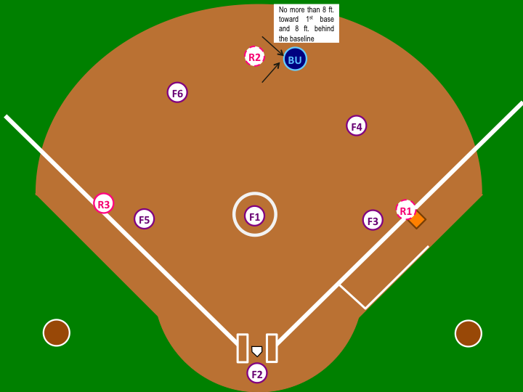
MODIFIED “C” POSITION R3 on 3rd Base Only R3 on 3rd & R1 on 1st Base 2 Outs & Full Count with Bases Loaded or R2 on 2nd Base & R1 on 1st Base

Slide 26
NO RUNNERS ON BASE – CLEAR OVER-THE-FENCE-HOMERUN
3BU
1BU
R3
PU

Slide 27
R1 ON 1ST BASE – CLEAR OVER-THE-FENCE-HOMERUN
3BU
3BU
1BU
R1
PU

Slide 28
MECHANICS POINTS OF EMPHASIS
PRESENT A UNITED FRONT
PLATE UMPIRE TIMING
3RD STRIKES
AVOID GAME INTERRUPTERS
DEVIATIONS
TAG-UPS
HOMERUN COVERAGE
STAYING OUTSIDE

Slide 29
BU
R2
F6
F4
BU
R3
R1
F5
F1
F3
F2

Slide 30
PLAYS & INTERPRETATIONS

Slide 31
SITUATION 1
May a player wear religious headwear?
AR1
Yes. Provided the use of safety equipment (e.g., batter’s helmet) is not compromised, a player may wear religious headwear.
SITUATION 2
May a HS game be played with foul poles but without outfield fencing?
AR 2
A HS softball contest shall not be canceled due to a field containing foul poles but no outfield fencing.
SITUATION 3
There seems to be a lot of talk about the Easton “Ghost” bat. Which bats are legal for HS play?
AR 3
The bats that meet the requirements of the rulebook are legal. The requirements include, but are not limited to, the 2000 or 2004 ASA/USA Certification Mark.

Slide 32
SITUATION 4
Are bats with the 2013 ASA Certification Mark legal?
AR 4
Not in HS play.
SITUATION 5
A player has a medical/NYSPHSAA waiver to wear a daith piercing/earring. Does it need to be taped?
AR 5
No.

Slide 33
SITUATION 6
I heard metal cleats are permitted in HS baseball, so they must be legal in HS softball, right?
AR 6
Wrong. Metal cleats are not permitted in HS softball. Metal cleats are permitted at the varsity, junior varsity and frosh/freshman levels. Metal cleats are not permitted in modified play. Updated 2020
SITUATION 7
With R3 on 3rd base and 2 outs, B4 lays down a squeeze bunt. R3 crosses home plate. Then, B4 is called out for 3-foot lane interference. Does R3’s run count since she crossed home plate before the 3-foot lane interference?
AR 7
No. No run shall score when the 3rd out of the inning is on the BR prior to reaching 1st base, regardless of how that out occurred.

Slide 34
SITUATION 8A
With R3 on 3rd base and R2 on 2nd base, F1 throws a passed ball. R3 advances aggressively toward home plate, but puts the brakes on when she realizes she would be out at the plate. R3 retreats back to 3rd base and is standing on 3rd base. R2 is also standing on 3rd base. F5 tags both R3 and R2 while they are standing on the base simultaneously. Who is out?
AR 8A
R2 is out. R3 is entitled to her base until she (1) advances to and reaches the next base or (2) is forced from the base as a result of the batter becoming a batter-runner (force play).
SITUATION 8B
What if on the same play, F5 tagged R2 standing on 3rd base right before R3 returned to 3rd base?
AR 8B
R2 would not be out at this point. 3rd base was not occupied by 2 runners at the same time and R2 was permitted to advance to 3rd base. She simply is not entitled to it if R3 returns and stands on 3rd base.

Slide 35
SITUATION 9A
The game is being played with a temporary fence. B1’s batted ball hits 6 inches below the top plain of the fence and “falls” over the fence. The fence was loose and “had some give.” The ball passed over the fence on the fly. Is this a homerun?
AR 9A
No. The batted ball must cross the natural plain of the top of the fence. In this case, pressure from the ball caused the fence to fold/roll. When the ball does this or “climbs” the fence, a 2 base award shall be granted.
SITUATION 9B
But what about the rule that says something like “if the ball hits the top of the fence and then goes over, it’s a home run?”
AR 9B
That is still true. However, the “top of the fence” means the actual top that faces upward toward the sky. “Top of the fence” does not mean the top couple of inches of the fence facing the field.

Slide 36
SITUATION 10A
With R2 on 2nd, B3 hits a long fly ball. The ball is caught & R2 tags up. Who’s responsible for what?
AR 10A
Because R2 is a sole runner and is on 2nd base, the base umpire is responsible for her tag up. The play on R2 going into 3rd base is the plate umpire’s responsibility. This mechanic is endorsed by NYSSO. Do not use another association’s mechanic if it deviates from this mechanic.
SITUATION 10B
Are there any possible deviations that NYSSO would accept on this play?
AR 10B
Yes. The SOLE exception is if the plate umpire is pinned at home plate because he/she must remain there to determine fair/foul and catch/no catch down the right field line. In that case, the plate umpire must loudly communicate this deviation to his/her partner by saying “take her” or “she’s yours” etc. This mechanic is a deviation and may only be used in the situation described above. Umpires cannot default to a deviation because they prefer to use outdated mechanics.
SITUATION 10C
What if R2 advances to 3rd base, the ball gets passed F5 and R2 attempts to advance home?
AR 10C
In this case, the plate umpire is responsible for getting back home and covering the play. This situation is clearly described in the NYSSO Manual. Unless the plate umpire drops dead on the field, the base umpire has absolutely no business covering home plate in the 2-umpire system.

Slide 37
SITUATION 11
Team A submitted an official line up card using the DP/Flex. After the 9th batter bats, the Flex bats, rather than the lead off batter. Is this batting out of order or something else?
AR 11
Batting out of order involves players 1-9 in the batting order, not the Flex. When the Flex bats without a line-up change being reported to the plate umpire, this is an unreported substitution. But that is only step one. Remember, there is no player penalty in NYSSO softball for an unreported substitution. With that said, step two is determining whether the Flex batted illegally. If the lead off batter was the DP, this can be ruled simply as an unreported substitution without penalty. However, if she batted for someone other than the DP, this move would be illegal because the Flex was not eligible to bat for someone other than the DP. The penalties imposed will depend on the timing of this infraction being brought to the plate umpire’s attention.
SITUATION 12
A batting helmet has a NOCSAE stamp, but no external warning label. Is this permitted?
AR 12
Effective 2018, HS no longer requires the external warning label. The NOCSAE stamp, however, is still required.

Slide 38
SITUATION 13
Team A’s head coach reports a change to the plate umpire. Team A’s head coach then says, “I’ll let them know” referring to the opposing team. Is this a proper procedure?
AR 13
No. Although there is technically no prohibition to the coach reporting the information, it is the responsibility of the plate umpire to notify the opposing team. The proper response from the plate umpire should be along the lines of “That’s okay, coach; I will let them know.”
SITUATION 14
B1 is a right-handed batter. B1 bats the ball, which lands just outside the batter’s box in fair territory. B1 takes her first step toward 1st base and steps on top of or kicks the ball with her left foot. When B1 does this, her right foot is still within the batter’s box, but her left foot is outside the batter’s box.
AR 14
B1 is out for interference. B1 did not meet the definition of being “within” the batter’s box when she contacted the batted ball.

Slide 39
SITUATION 15A
R2 from 2nd base is advancing home on B3’s hit to the outfield. F2 is legally blocking the plate as R2 attempts to do a slide by and sneak her hand in. F2 misses the tag and R2 misses the plate. Can F2 make a live ball appeal for R2 missing home plate?
AR 15A
Yes, any player in possession of the ball may execute a live ball appeal. To do so, she must execute the appeal prior to the runner “fixing” her base running error. The player in possession of the ball may either tag the runner or tag the base where the “violation” occurred. In this case, F2 can simply make her live ball appeal known to the umpire and step on home plate prior to R2 touching home.
SITUATION 15B
Then why do catchers always chase after the runner who misses home plate?
AR 15B
Probably because they weren’t taught properly and because many don’t know how to execute a live ball appeal.

Slide 40
SITUATION 16A
B1 hits and over-the-fence home run. As she rounds 3rd base and is heading home, she removes her helmet and tosses it in the air in celebration. Is B1 out for intentionally removing her helmet?
AR 16A
No. There are multiple elements necessary to call a runner out for intentionally removing her helmet. One of those elements is that the ball is live. An over-the-fence home run becomes a dead ball.
SITUATION 16B
If a runner does intentionally remove her helmet during a live ball, why does the rule state that doing so does not remove the force?
AR 16B
It is intended to prevent the offense from benefiting from violating the rule. For instance, with R1 on 1st base, B2 hits a tailor made double play. Seeing this, B2 intentionally removes her helmet just prior to the execution of R1’s out at 2nd base. Imagine that R1 were to be called safe because the defense attempted to execute a force out rather than a tag out, which ordinarily would be necessary when the BR is declared out? That would fundamentally change how the game is played and could not be tolerated.

Slide 41
SITUATION 17
The 3rd base coach requests time and asks to have the “last batted out” run for the runner on 1st base. She says, “We do that every game.”
AR 17
This is not legal. If an eligible courtesy runner is available for a pitcher or catcher, the team may use her. If an eligible substitute is available, she may be used. If neither exists, then R1 must run or be declared out for not running.

Slide 42
SITUATION 18A
The 3rd base coach requests time and reports to the plate umpire “#12 is batting for #20 and then #20 is going to re-enter.” Is this permissible?
AR 18A
Projected substitutions are not permitted. Projected substitutions involve multiple changes involving the same player. The umpire should state, “Coach, I’m entering #12 for #20; but, you’re required to report any future change with her.”
SITUATION 18B
Does that mean that the coach can’t report multiple batting changes? For example, if the team is ahead by 10 runs and the coach reports, “I’m entering #1 for #2, #3 for #4 and #5 for #6” is that permitted?
AR 18B
Yes. Although there are multiple changes, they involved different players, as opposed to multiple changes with the same player.
For what it is worth, just this past weekend a runner on second was gesturing location to the batter and the third base coach would yell “sit” when he knew the pitcher would throw a change up. Both are perfectly legal.
An umpire would be in error to issue a directive to a coach to stop calling location.

Slide 43
SITUATION 19: An offensive coach is yelling out location of pitches once he sees where the catcher is setting up. Is this “unsporting conduct?” Should any warnings be issued?
AR 19
There is no prohibition on stealing signs, pitches or location; nor is there a prohibition against using that information; provided in both cases it is not done illegally. Illegally is limited to cases involving the use of electronic equipment, game personnel going where they don’t belong, etc.
The solution is for the defensive team to set up later or more subtly. There are other solutions, but I cannot recommend they be implemented. Because, as described, there was no illegal conduct, there is nothing for which to issue a warning. Warnings should only be used when an actual violation occurs and there must be a penalty for a subsequent violation.
SITUATION 20
B1 comes to bat. After the first pitch to her, the plate umpire sees she is wearing jewelry. The plate umpire immediately ejects B1 and her head coach. Is this correct?
AR 20
No. If a player is wearing jewelry, she should be directed to correct the situation. She should be allowed a reasonable amount of time to correct it and then may play again. If she cannot or is unwilling to correct it, then a legal substitute would be required to take her spot. The only time an ejection would come into the picture is (1) if the same player put the jewelry back on after taking it off (unsporting conduct) or if she had tape covering the jewelry, lied about the fact that jewelry was under the tape and it was later discovered to be jewelry. In these cases, ejection is an option, which umpires are not required to exercise.

Slide 44
SITUATION 21A
Does the protection that an obstructed runner garners change depending on whether she is obstructed advancing to a base or returning to a base?
AR 21A
No. An obstructed runner is protected between the two bases where the obstruction occurred and to the base she would have reached, in the umpires’ judgment, had she not been obstructed.
SITUATION 21B
F3 obstructs BR rounding 1st base on an outfield hit. F8 charges the ball, fields it cleanly and throws it directed to F6 covering 2nd base. BR never would have reached 2nd base safely. As soon as BR is obstructed, her 1st base coach yells “go to 2nd base.” BR is thrown out at 2nd base. What is the proper ruling?
AR 21B
Because BR was protected between 1st and 2nd base and was tagged out between those bases, the ball becomes dead. The umpires should safely return BR to 1st base

Slide 45
SITUATION 21C
F3 obstructs BR returning to 1st base on an outfield hit. F8 charges the ball, fields it cleanly and throws it directed to F6 covering 2nd base. BR never would have reached 2nd base safely. As soon as BR is obstructed returning to 1st base, her 1st base coach yells “go to 2nd base.” BR is thrown out at 2nd base. Does the ruling differ from Situation / AR 21B?
AR 21C
No. An obstructed runner is protected regardless of whether she is advancing to or returning to a base.
SITUATION 21D
When there is obstruction on BR rounding or returning to 1st base (e.g., on an outfield single), is there any reason the BR shouldn’t attempt to advance to 2nd base?
AR 21D
No. Provided BR doesn’t commit an act of interference, miss a base, etc., this is, in essence, a “free play.” If BR’s advancement draws a poor throw or the ball is misplayed and she reaches 2nd base safely, good for her. If she’s thrown out by 50 feet after never having a realistic chance of getting to 2nd base safely, the ball is dead and she is returned to 1st base.

Slide 46
TEST PREP
Frequently Missed Questions
Plays & Interpretations
New Rules
Pitcher Set Up
Pitcher Motion
Illegal Pitch
Certification Marks
Metal Cleats
Helmets
Mechanics

