Slide 1
Lineup Card Management
SUP 2014

Slide 2
The following information shall be recorded on the lineup card:
First, last names, uniform numbers and position of starting players, listed in the order in which they are to bat.
Exception: First names may be omitted from the written lineup card as long as they are printed on the card’s roster.
First, last names and uniform numbers of all eligible substitutes.
First and last name of the head coach, or co-head coaches.

Slide 3
Pre-Game Meeting:
Each team must submit a complete lineup card to the plate umpire at the pregame meeting at home plate.
Confirm that the lineup card has players first, last names and positions listed along with all substitutes.
Make sure there are no duplicate numbers.
Make sure there are at least 9 or10 players listed in the starting position.

Slide 4
Pre-Game Meeting
If the DP/FLEX is used, verify with the coach the player listed as the DP is the one who will hit for the FLEX in the 10th spot.

Slide 5
DP vs FLEX
DP : Plays Offense
Bats for the FLEX
FLEX : Plays Defense

Slide 6
FLEX Duties:
Can play defense for
any player.
Run for the DP.
Hit for the DP.

Slide 7
DP Duties:
She can only run for the FLEX.
She can only bat for the FLEX.
She may play defense for any player.

Slide 8
Note:
Players not listed on the lineup card are not eligible to play.
All players listed in the starting lineup must be in uniform, in the dugout area and are available to play at the start of the game.
The umpire may ask for the lineup card to be corrected before accepting it as official.

Slide 9
Helpful hint:
As a preventative measure to avoid possible re-entry eligibility infractions, prior to the game, circle all starters that are listed on the bottom of the line up card.

Slide 10
What must be recorded?
All substitutions
All re-entries
All defensive conferences
All offensive conferences
All defensive changes
All changes concerning the DP or FLEX
All warnings

Slide 11
When accepting a lineup card change:
Never accept or allow changes that are illegal.
When accepting changes, take your lineup card out and ask the coach to remain with you while you record changes.
Confirm the changes by repeating the names and numbers back to the coach.
Take one change at a time.
Check to make sure players entering the game are wearing the same numbers listed on the card.

Slide 12
Tracking the players movement
The coach substitutes
Tammy Rogers # 8 for Mary Smith #4 .
The plate umpire would:
Locate Tammy Rogers # 8 on the line up card
circle # 8
and then place # 8 in Mary Smith’s slot.

Slide 13
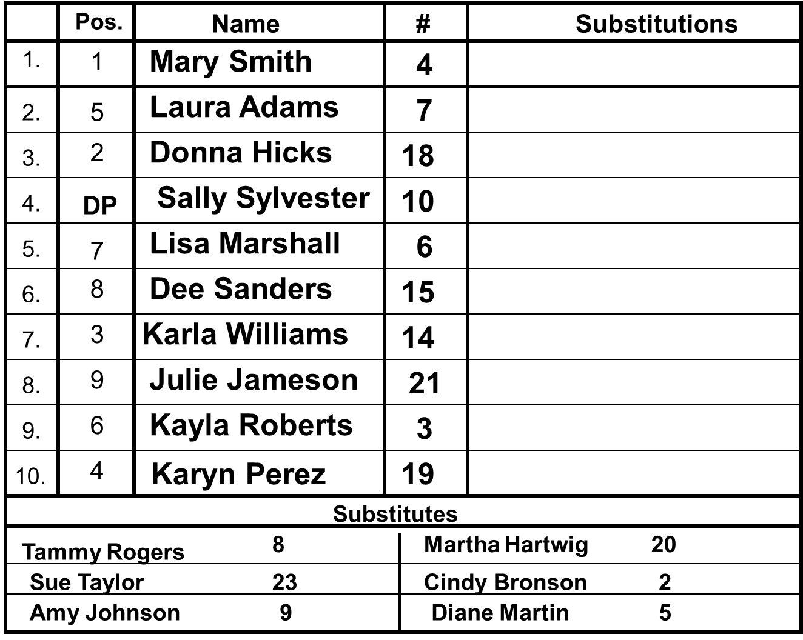
8

Slide 14
To track the DP or FLEX use an “X”instead of a number
An “X” in the DP slot means the FLEX is playing offense (batting) for the DP.
An “X” in the FLEX slot means the DP is playing defense (fielding) for the FLEX.

Slide 15
DP/FLEX:
An “X” that is circled in the line up indicates that the team is playing with 10 players.
A circled “X” in the DP slot, indicates that the FLEX was batting (offense ) for the DP and she is now fielding only (defense).
A circled “X” in the FLEX slot, indicates that the DP was playing defense for the FLEX at one time but she is now only hitting(offense), or she may play defense for someone else.

Slide 16
DP/FLEX
The DP/FLEX can leave her slot in the lineup & return to that same slot once (re-entry).
Each player may use each other’s slot in the lineup but not at the same time.
DP can play defense for any of the other 9 players in the lineup .
The DP and FLEX can be on defense at the same time.
The FLEX can only play offense for the DP .
The DP cannot be on offense at the same time as the FLEX.

Slide 17
Review Starters:
The starters are the first 9 or 10 players listed on the lineup card.
Starters can not change slots on the lineup card.
Starters have been in the game once.
Once a starter is circled, she may not reenter at any time.

Slide 18
Review Substitutes:
Substitutes are listed on the bottom of the lineup card.
Substitutes who are circled have entered the game.
Substitutes who are in the game (circled)
may not re-enter the game.

Slide 19
Examples:

Slide 20
First Change:
After reviewing the lineup card and accepting it from the coach as official, the coach asks the following question.
Can I change the lineup card to use DP/FLEX?
Your answer:
Coach you can not add the 10th player to the lineup. This needed to be done before the lineup was submitted as official.

Slide 21
Pos.
Name
#
Substitutions
1.
1
Mary Smith
4
2.
5
Laura Adams
7
3.
2
Donna Hicks
18
4.
4
Sally Sylvester
10
5.
7
Lisa Marshall
6
6.
8
Dee Sanders
15
7.
3
Karla Williams
14
8.
9
Julie Jameson
21
9.
6
Kayla Roberts
3
Official card only has 9 players
10.
Substitutes
Tammy Rogers
8
Martha Hartwig
20
Sue Taylor
23
Cindy Bronson
2
Amy Johnson
9
Diane Martin
5

Slide 22
Second Change:
Coach wants to substitute # 23 for # 21.
Legal?
Yes, straight substitution, you would find # 23 in substitutes, if she is not circled you can use her. Circle # 23 and place her in Sub column for #21
What if # 23 was circled?
She would be ineligible and you would tell the coach this can not be done.

Slide 23
23

Slide 24
Practice Line Up Changes

Slide 25
Practice Line Up Changes:
First Change:
Diane Martin # 5 substituting
for Julie Jameson #21
Find number # 5 in the substitutes
circle # 5
then place her in for # 21.

Slide 26
5

Slide 27
Practice Line Up Changes:
Second Change:
Tammy Rodgers # 8 substitutes the
DP Sally Sylvester #10.
Find number # 8 in the substitutes,
circle # 8
then place her in for # 10.

Slide 28
8
5

Slide 29
Practice Line Up Changes:
Third Change:
Karyn Perez # 19, the FLEX, running for Tammy Rodgers # 8
#19 is the Flex, #8 is the DP.
The Flex can play offense for the DP put an X in the DP slot.
Circle # 8, she has left the game.

Slide 30
8
X
5

Slide 31
Practice Line Up Changes:
Note:
You can only have ONE un-circled number or
X in each of the slots on the line up card.

Slide 32
Practice Line Up Card:
Fourth Change:
Re-enter Sally Sylvester #10 to hit.
Find #10 – if she is not circled,
she can re-enter.
Circle the X

Slide 33
8
X
5

Slide 34
Practice Line Up Changes:
Fifth Change:
Karyn Perez # 19 will run for
Sally Sylvester #10.
#19 is the Flex, #10 is the DP. The Flex can run for the DP.
Put an X in the DP slot.
If someone comes into a slot, someone must go out of that slot.
Circle # 10.

Slide 35
8
X
X
5

Slide 36
Practice Line Up Card:
Sixth Change:
Re-enter Julie Jameson #21.
Find #21 – if she is not circled, she can come back in.
If someone comes into a slot, someone must go out of that slot.
Circle # 5.

Slide 37
8
X
X
5

Slide 38
Practice Line Up Card:
Seventh Change:
Diane Martin # 5 substituted for
Donna Hicks # 18
Tell the coach she cannot use # 5 as a substitute, because she was already used in the game.

Slide 39
8
X
X
5

Slide 40
Keys to Remember:
If a player is circled she can not re-enter.
If someone comes into a slot,
someone must go out of that slot.
As long as the DP has a bat and is on offense and the FLEX uses her glove to play defense there is no substitution.

